Slide 1
Ride Analytics on new York City taxi data
Sai Duth Deekshit G,
Rohit Reddy G,
Rohith Varma Jampana,
Sumanth D.

Slide 2
contents
Introduction
Project Description
Back Ground
Problem definition and Solutions
Future Work
References

Slide 3
introduction
Transportation plays a vital role in large cities
Taxi mode of transportation has become a key player in large cities of united states and other countries.
In NYC approximately 50,000 vehicles and 1,00,000 drivers exist.
Different variety of service providers are Uber, Yellow Taxi, Green Taxi etc.
The data that contain ride details was made available by NYC taxi and Limousine commission.
We use these details to perform analytics on ride data that would benefit businesses of various types and government.

Slide 4
Project description
In this project we perform analytics on NYC taxi data and find solutions to queries like :
Most common pick up and drop-off locations
Busiest routes for taxis
Most revenue generated areas for cabs
Popularity of the places
Know whether driver took the correct route or not
Find popular places between pick up and drop off locations

Slide 5
Background work
Yufei Tao, Dimitris Papadias, Qiongmao Shen. “Continuous Nearest Neighbor Search”. Proceedings of the 28th VLDB conference, Hong Kong, China, 2002.
Apache Spark:
An engine for processing big data in fast and efficient manner
Contain several built in modules for streaming, SQL, machine learning and graph processing
Provide an API known as Resilient Distributed Dataset (RDD)
RDD allows to develop both iterative algorithms which require dataset to visit several times in a loop and exploratory data analysis(repeated database style querying of data)
Process and execute batch jobs much better and faster than MapReduce.
It run on Hadoop along with other tools like Hive Pig which come under Hadoop ecosystem

Slide 6
Cont…
Yelp API which provide us the business name and address around the given location(latitude and longitude)
Google Matrix Distance API provide us road network distance between two locations by taking coordinated of two locations as input

Slide 7
Software & hardware requirements
Query Languages: DBMS, SQL
Programming Languages: Scala, Python, Java
Online tools: www.databricks.com (For running Scala or Python cells and storing the data)
API’s : YELP API, Google Distance Matrix API
Windows or MAC OS, RAM:4GB or more, HDD: Minimum 50GB, Internet connection

Slide 8
Problem definition
The problem is defined in three stages:
1st Stage: Data cleaning and Analysis on Ride data
2nd Stage: Finding popular places between pick up and drop off location
3rd Stage: Visualization of results

Slide 9
Cleaning and analysis on ride data
Data Set Link: http://www.nyc.gov/html/tlc/html/about/trip_record_data.shtml
The initial data set contain unnecessary fields which are of no use in the analysis like VendorId, RateCodeID, Store_and_fwd_flag, Tolls_amount, Improvement
Also, remove invalid data (check for blank entries and delete them)
The final data set that was cleaned contains the following fields which will be used for our analysis:
Pickup_datatime, dropoff_datetime, passenger_count, trip_distance, pickup_longitude, pickup_latitude, dropoff_longitude, dropoff_latitude, payment_type, fare_amount, trip_amount

Slide 10
Contn…
Now we perform Analysis on ride data to find:
Most common pick up and drop-off locations
Busiest routes for taxis
Most revenue generated areas for cabs
Popularity of the places
Know whether driver took the correct route or not
Find popular places between pick up and drop off locations

Slide 11
Finding popular places between pick up and drop off location
In this stage we display the popular places along the route in which the ride is going to take place.
In doing so, the first step would be to select the source and destination
The second step would be to find the continuous nearest neighbors along source and destination
Third step would be to check the popularity of the places that we got as a result from step two which is done based on the count of rides people took to that location
Finally we display the top 5 results to the user

Slide 12
Algorithm for finding popular places between two points:
Select source and destination location coordinates which will be the pick-up and drop-off coordinates
Call findNeighbors ( ) method which will return a set of <Point, interval>. Where, Point is the nearest neighbor and interval is the interval for which Point is nearest neighbor
Store the result obtained above and use findPopularity ( ) method to find the popularity of the above obtained result
Display top 5 results based on the popularity

Slide 13
Challenges and solution
We have some challenges while finding nearest neighbors like The time taken to find the neighbors, unnecessary visitations to objects
Use R-tree indexing for storing and indexing the data
How can we avoide unnecessary visitations and decreases the time to find the neighbors?
First take MBR E
Given E and q (line segment), subtree of E contains qualifying points(nodes that can be visited) only
If mindist (E, q) < SLmaxd else it is not qualified
If dist(Si, Si NN) > mindist (Si, E)
Also, for entries that are closer to line segment there is high possibility to qualify
Entries that satisfy the above condition are accessed in increasing order of their minimum distances to q (distance is found using Google Distance Matrix API)

Slide 14
CNN Contn..
Continuous Nearest Neighborhood integrated with Google Distance Matrix API
Google Distance Matrix API :
https://maps.googleapis.com/maps/api/distancematrix/outputFormat?parameters
OutputFormat can be either JSON or XML format
Parameters can be “origins = latitude, longitude | latitude, longitude”
For querying multiple points we can use Polyline Algorithm format

Slide 15

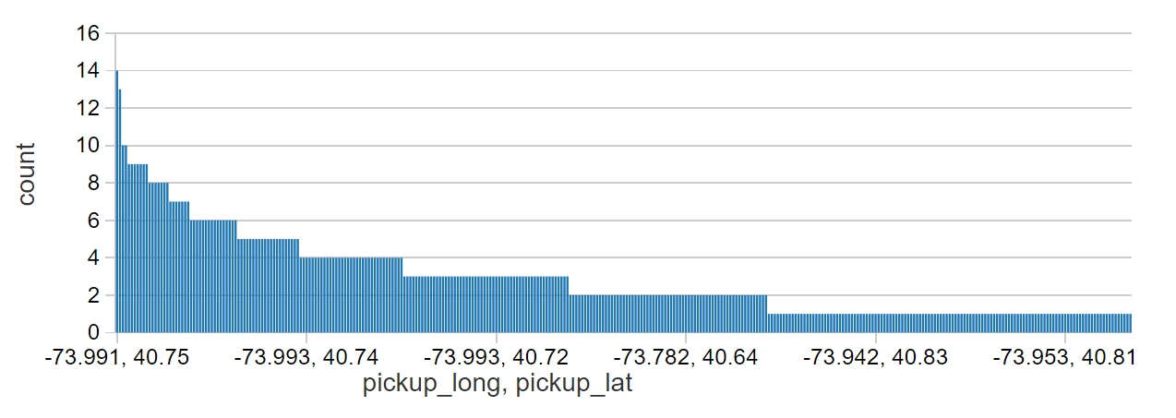
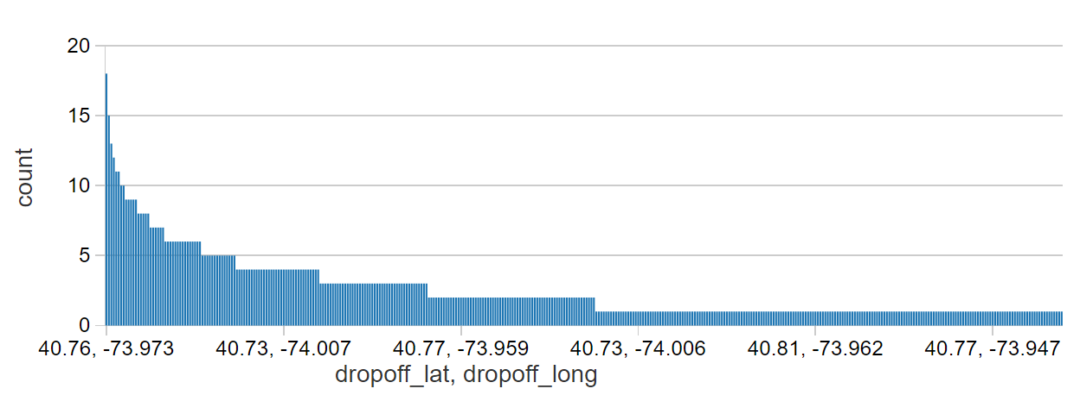
Visualization

Slide 16
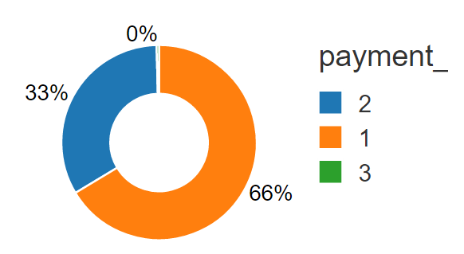
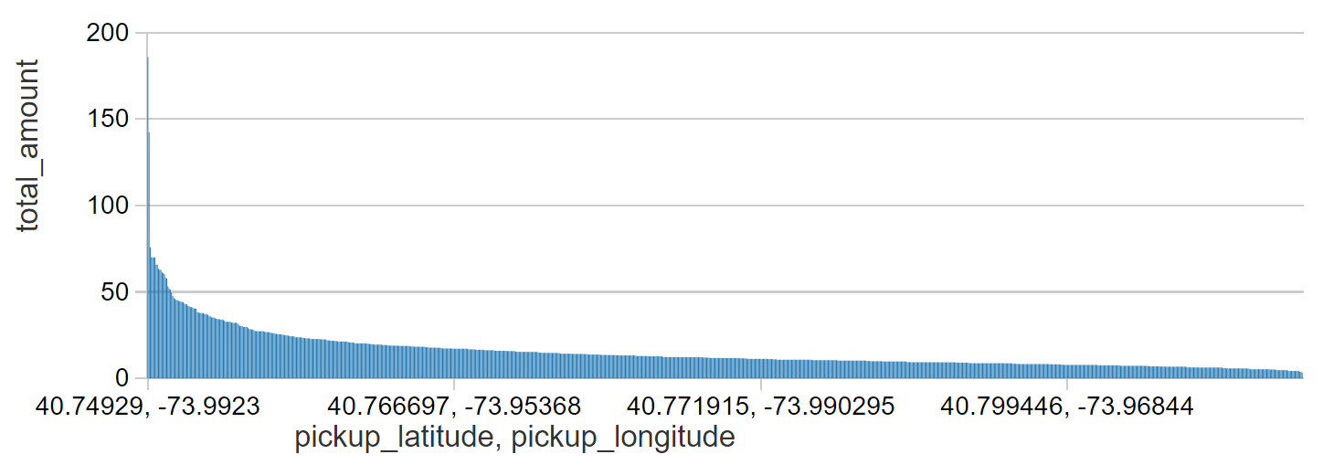
Contn..

Slide 17
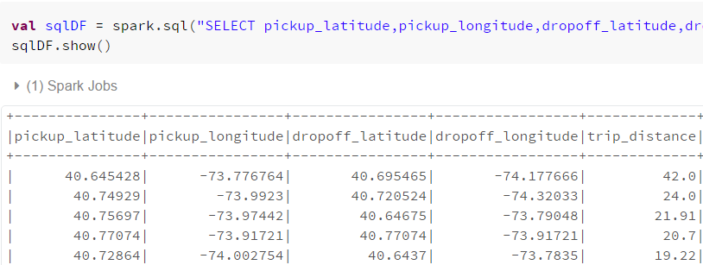
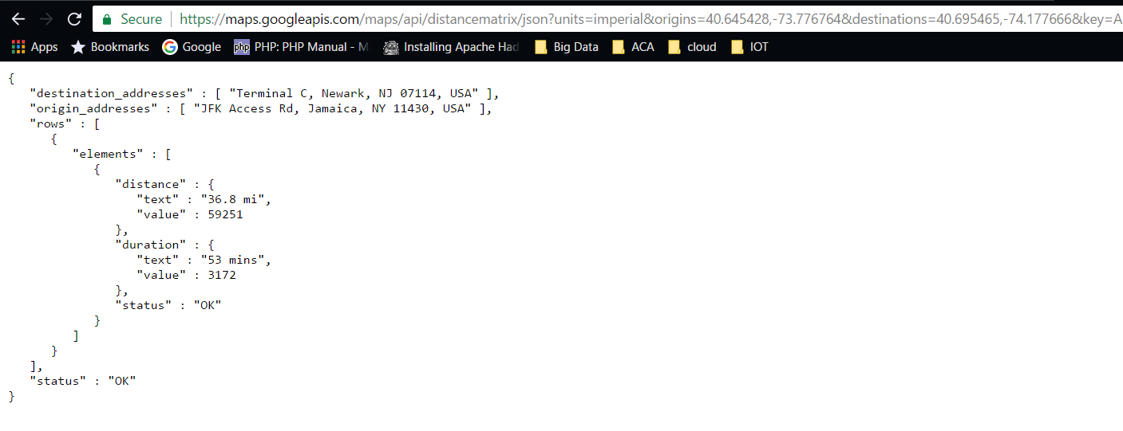
Contn..

Slide 18
Future work
The result of analysis can be used to help taxi drivers to decide in which area they need to go so they get maximum customers and boost their business
New taxi business can also gain from the analysis
Traffic analysis: Finds which routes and times of the day are heavy on traffic
Provide visualization like heated maps and route visualization
Decrease traffic congestion and reduce CO2 emissions by start using public transport instead of individual transport
Find potential for pool/sharing taxi business

Slide 19
references
NYC Taxi & Limousine Commission. http://www.nyc.gov/html/tlc/html/about/about.shtml
Yufei Tao, Dimitris Papadias, Qiongmao Shen. “Continuous Nearest Neighbor Search”. Proceedings of the 28th VLDB conference, Hong Kong, China, 2002.

Slide 20
THANK YOU quERIES????

